Slide 1
Container architecture (Docker)
Phạm Hà Hoàng Nam
Nguyễn Anh Quân
Nguyễn Song Toàn
Tạ Việt Hùng
Bùi Anh Huy

Slide 2
What is Docker?

Slide 3
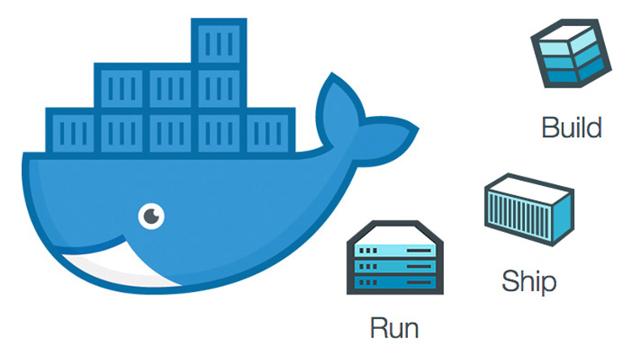
Overview
Docker is an open platform for developing, shipping, and running applications.
Docker enables you to separate your applications from your infrastructure so you can deliver software quickly.
You can manage your infrastructure in the same ways you manage your applications.
You can significantly reduce the delay between writing code and running it in production.

Slide 4
Containers vs. Virtual Machines

Slide 5
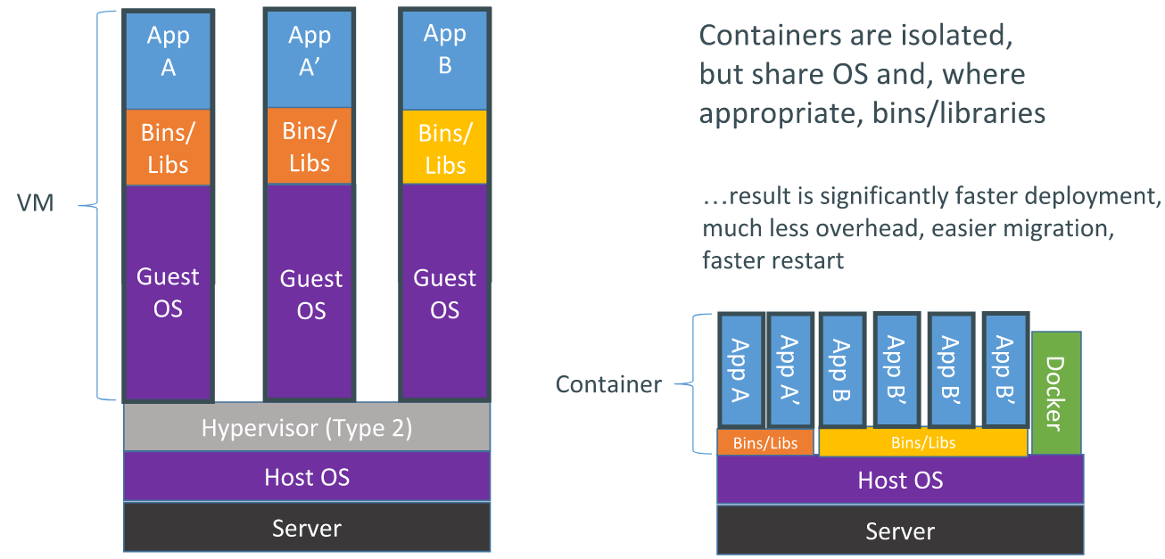
Containers vs. Virtual Machines
Containers provide a way to virtualize an OS so that multiple workloads can run on a single OS instance. With VMs, the hardware is being virtualized to run multiple OS instances. Containers’ speed, agility, and portability make them yet another tool to help streamline software development.

Slide 6
Docker Architecture

Slide 7
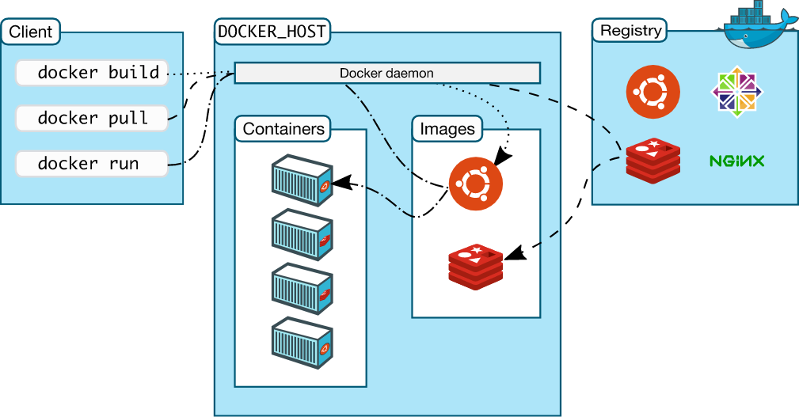
Docker Architecture
Docker uses a client-server architecture.
The Docker client talks to the Docker daemon, which does the heavy lifting of building, running, and distributing your Docker containers. The Docker client and daemon can run on the same system, or you can connect a Docker client to a remote Docker daemon.

Slide 8
Docker Architecture
The Docker client and daemon communicate using a REST API, over UNIX sockets or a network interface. Another Docker client is Docker Compose, that lets you work with applications consisting of a set of containers.

Slide 9
Why use Docker?
Fast, consistent delivery of your applications
Responsive deployment and scaling
Running more workloads on the same hardware

Slide 10
Thanks you for listening

